Slide 1
Struct, Operator Overloading & Classes
Unit-04

Slide 2
Struct
Unit-04.01

Slide 3
Struct……
In C++, a struct is a user-defined aggregate data type that can contain member variables (fields) and member functions (methods). It is very similar to a class, with the main difference being that members of a struct are by default public, while members of a class are by default private.

Slide 4
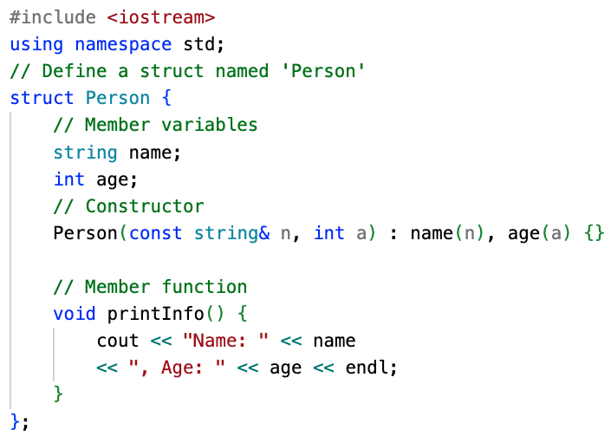
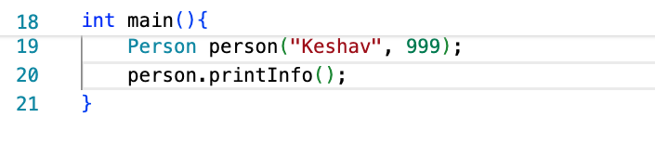

Struct……

Slide 5
Struct [Constructor]……
Let’s do some dissection…..

Slide 6
Struct [Constructor]……
Let’s do some dissection…..
DELETE CONSTRUCTOR??

Slide 7
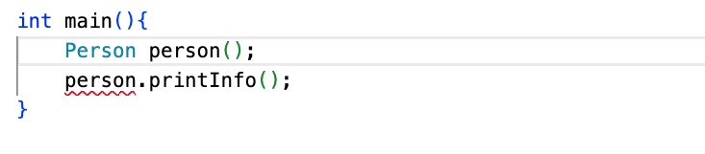
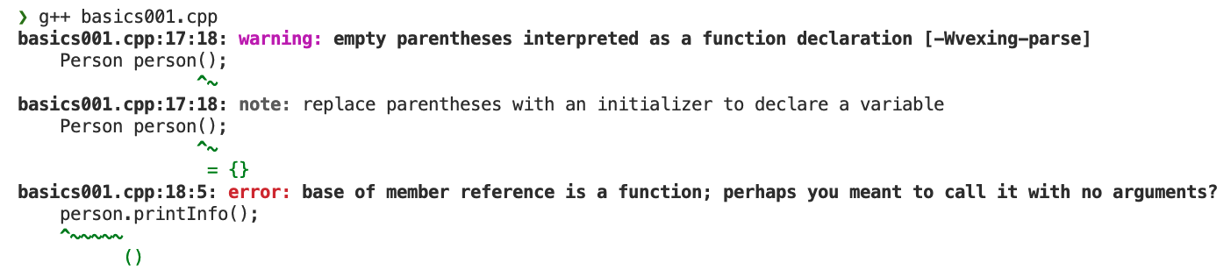
Struct [Constructor]……
Let’s do some dissection…..

Slide 8
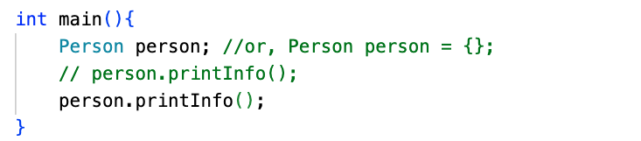


Struct [Constructor]……
Let’s do some dissection…..

Slide 9

Struct [Constructor]……
Let’s do some dissection…..
Not having a constructor is equivalent to having empty constructor like below…

Slide 10
Struct [Constructor]……
What did we learn?
Constructor is a way of saying, this is how I want to define my structure…

Slide 11
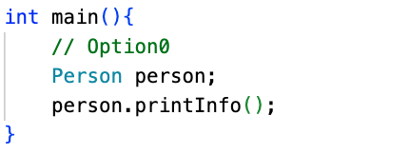
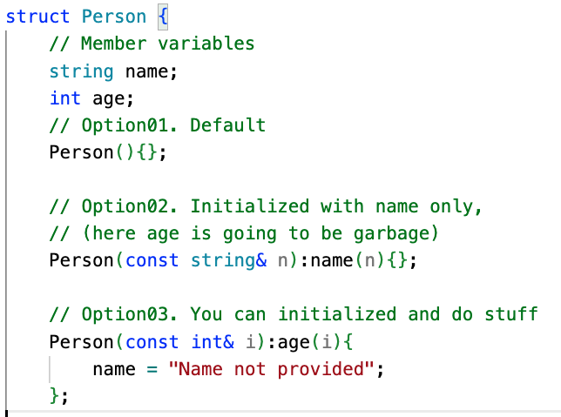

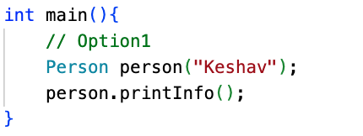

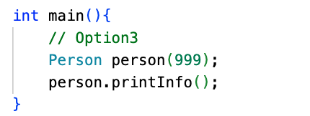

Struct [Constructor]……
Note: We already did Option2, that is initializing with all parameters

Slide 12
Struct [Constructor]……
Note: We already did Option2, that is initializing with all parameters

Slide 13
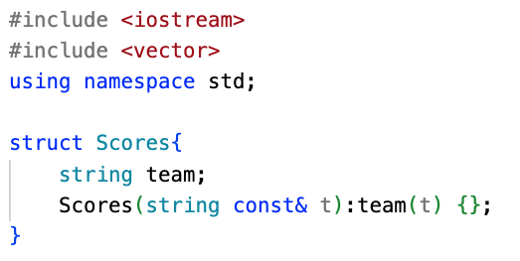
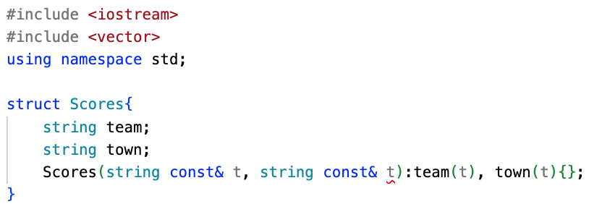
Struct [Constructor]……
What is a best way to reference the member?
;
;

Slide 14
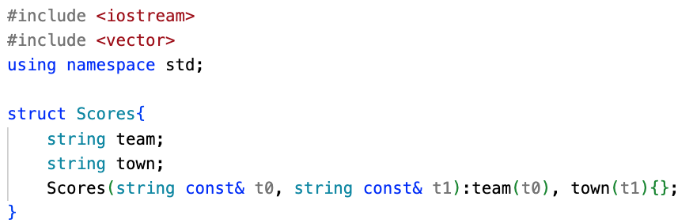
Struct [Constructor]……
What is a best way to reference the member?
Resolution: do not use same argument twice in constructor, may be do t0, t1
;
;

Slide 15
Struct [Constructor]……
What is a best way to reference the member?
Resolution: do not use same argument twice in constructor, may be do t0, t1
BUT THIS IS NOT A GOOD PRACTICE
WHAT IF…we can use actual variable name
;
;

Slide 16
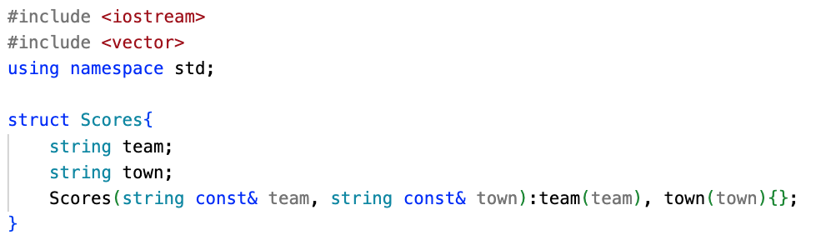
Struct [Constructor]……
What is a best way to reference the member?
Resolution: do not use same argument twice in constructor, may be do t0, t1
BUT THIS IS NOT A GOOD PRACTICE
WHAT IF…we can use actual variable name
;
;

Slide 17
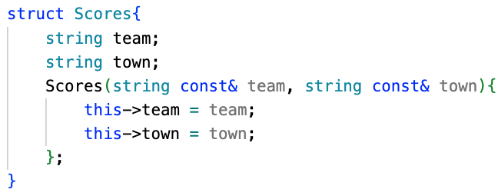
Struct [Constructor]……
Following operations are identical
;
;

Slide 18
Struct [Constructor]……
;
‘this’ is called a pointer, which is a reference to the current instance of the structure
(Good Habit: Use this-> to resolve naming conflicts)

Slide 19
Struct [Constructor]……
;
‘this’ is a pointer, which is a reference to the current instance of the structure
(Good Habit: Use this-> to resolve naming conflicts)

Slide 20
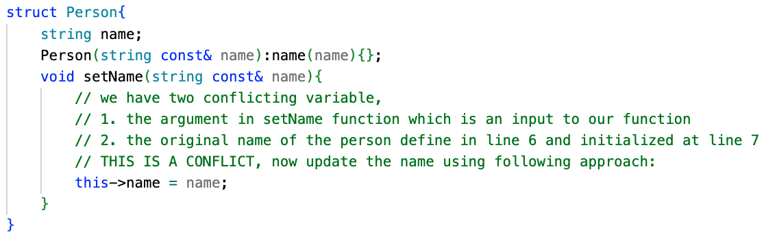
Struct [Constructor]……
;
‘this’ is a pointer, which is a reference to the current instance of the structure
(Good Habit: Use this-> to resolve naming conflicts)

Slide 21
Struct ……
CASE STUDY

Slide 22
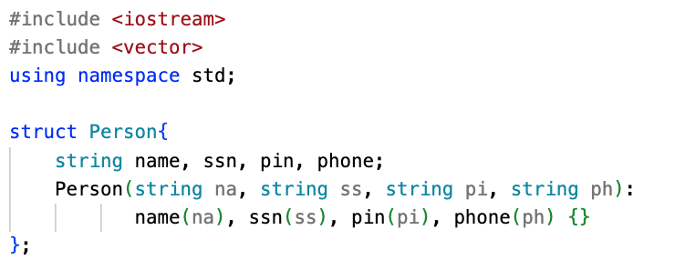
Struct [….]……

Slide 23
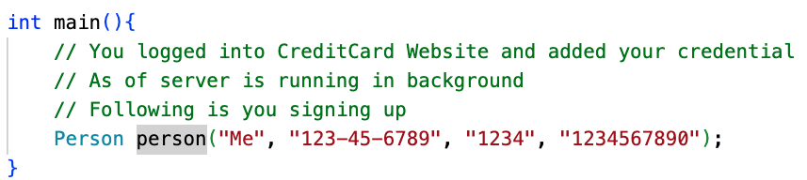
Struct […]……

Slide 24
Struct […]……

Slide 25
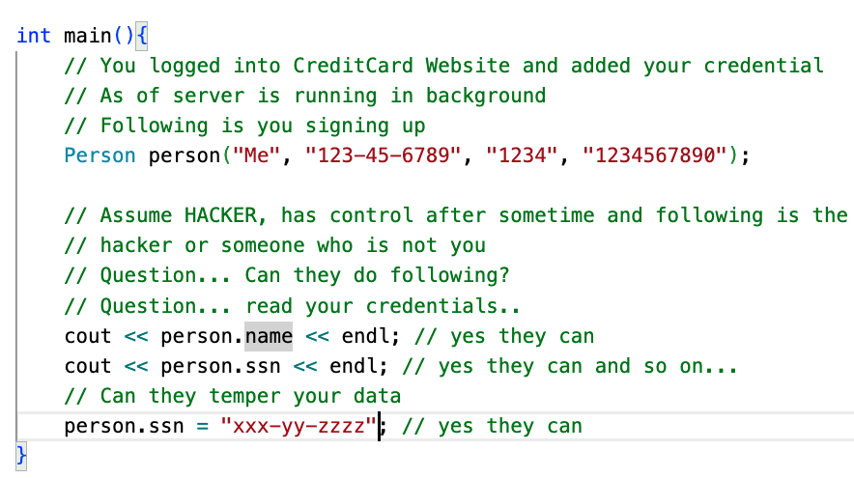
Struct […]……
Find the typo!!!

Slide 26
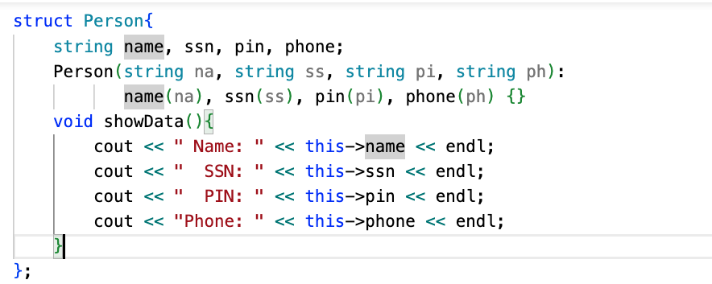
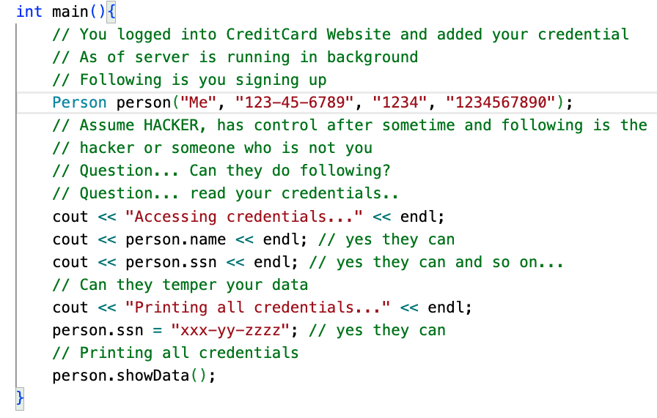
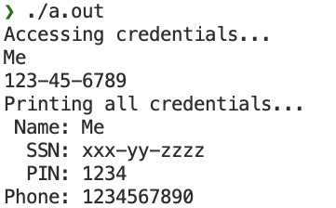
Struct […]……

Slide 27
Struct [ACCESS IDENTIFIER]……
LIMITING ACCESS….?

Slide 28
Struct [ACCESS IDENTIFIER]……
‘access-specifiers’ like, private, protected, public can be used to limit the access of member outside of struct, by default everything is public. As of now lets ignore protected.

Slide 29
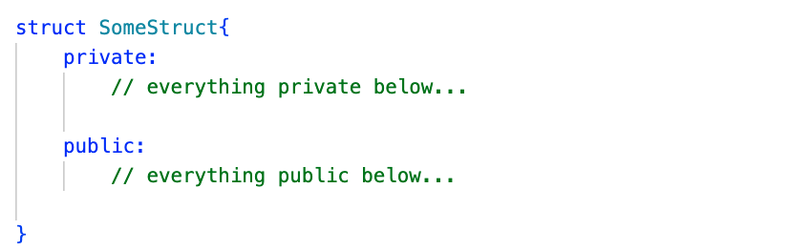
Struct [ACCESS IDENTIFIER]……
ACCESS WITHIN STRUCT ONLY
ACCESS FROM
MOCHAS JAVA..
OR ANY COFFEE PLACE YOU LIKE….

Slide 30
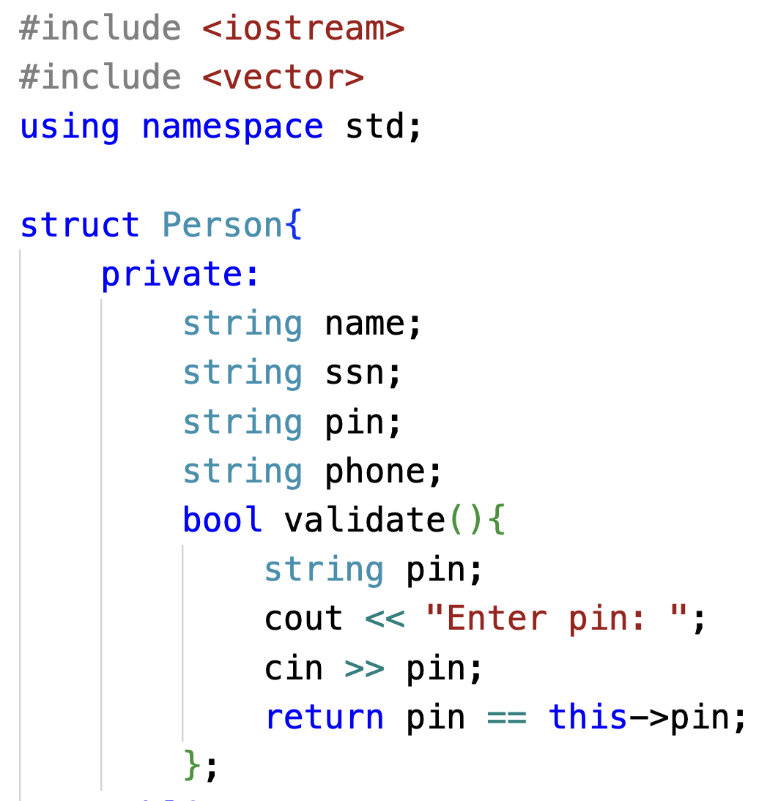
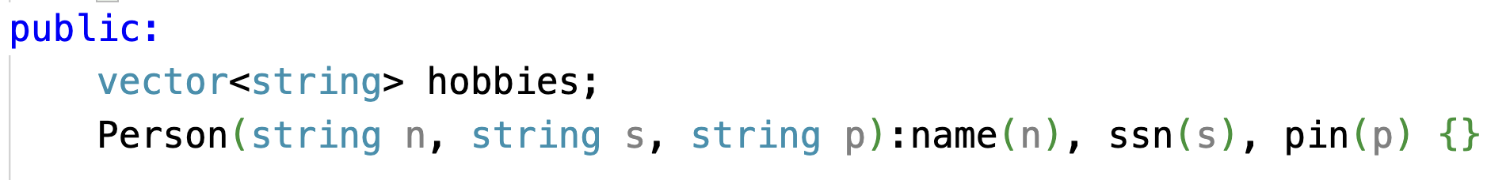
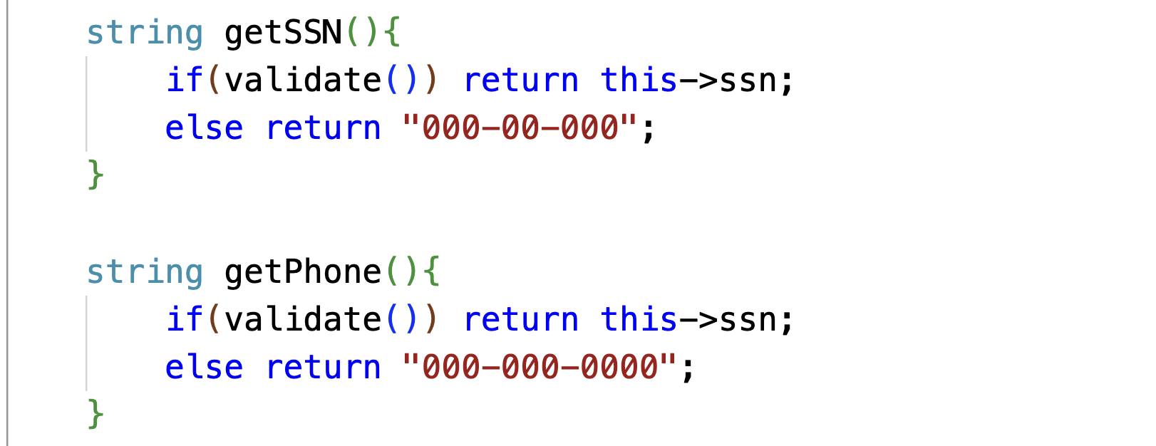
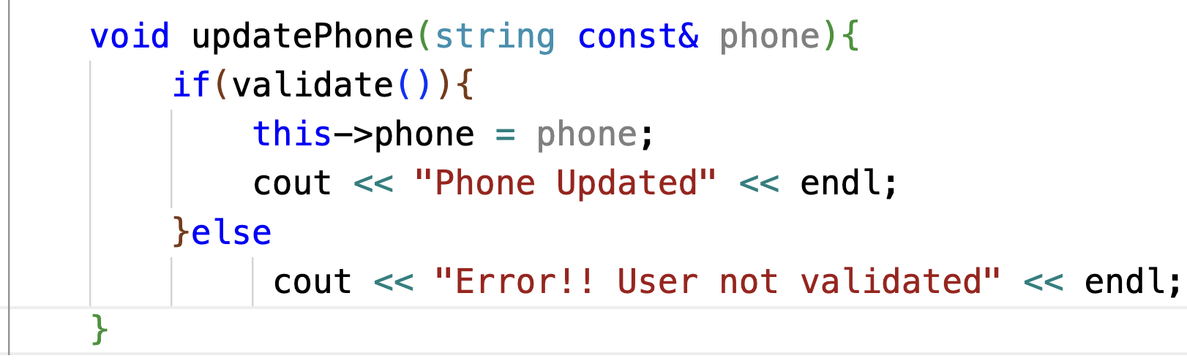
Struct [ACCESS IDENTIFIER]……
WARNING!!! THIS IS A BAD CODE

Slide 31
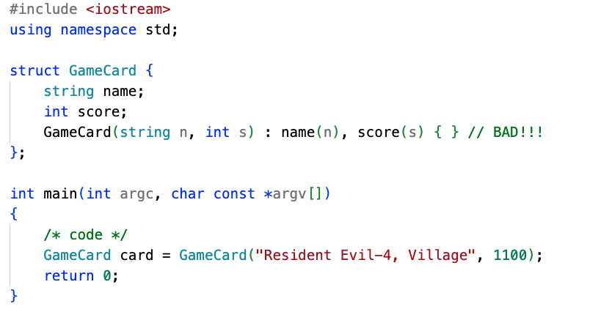
Struct […..]……
What will when program ends?

Slide 32
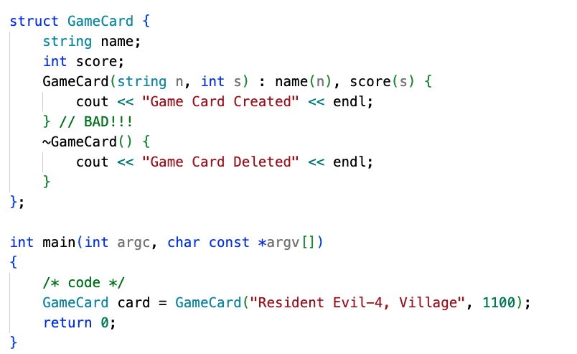
Struct [Destructor]……

Slide 33
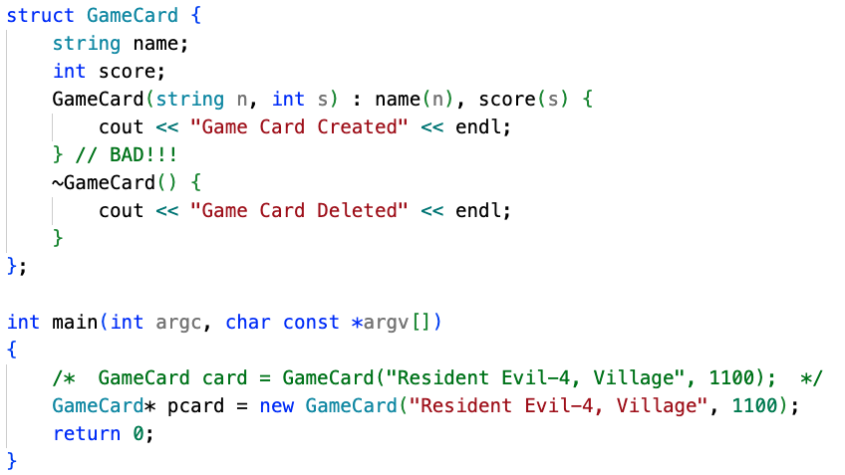

Struct [POINTERS]……

Slide 34

Struct [POINTERS]……
You must de-allocate memory while using pointers.

Slide 35
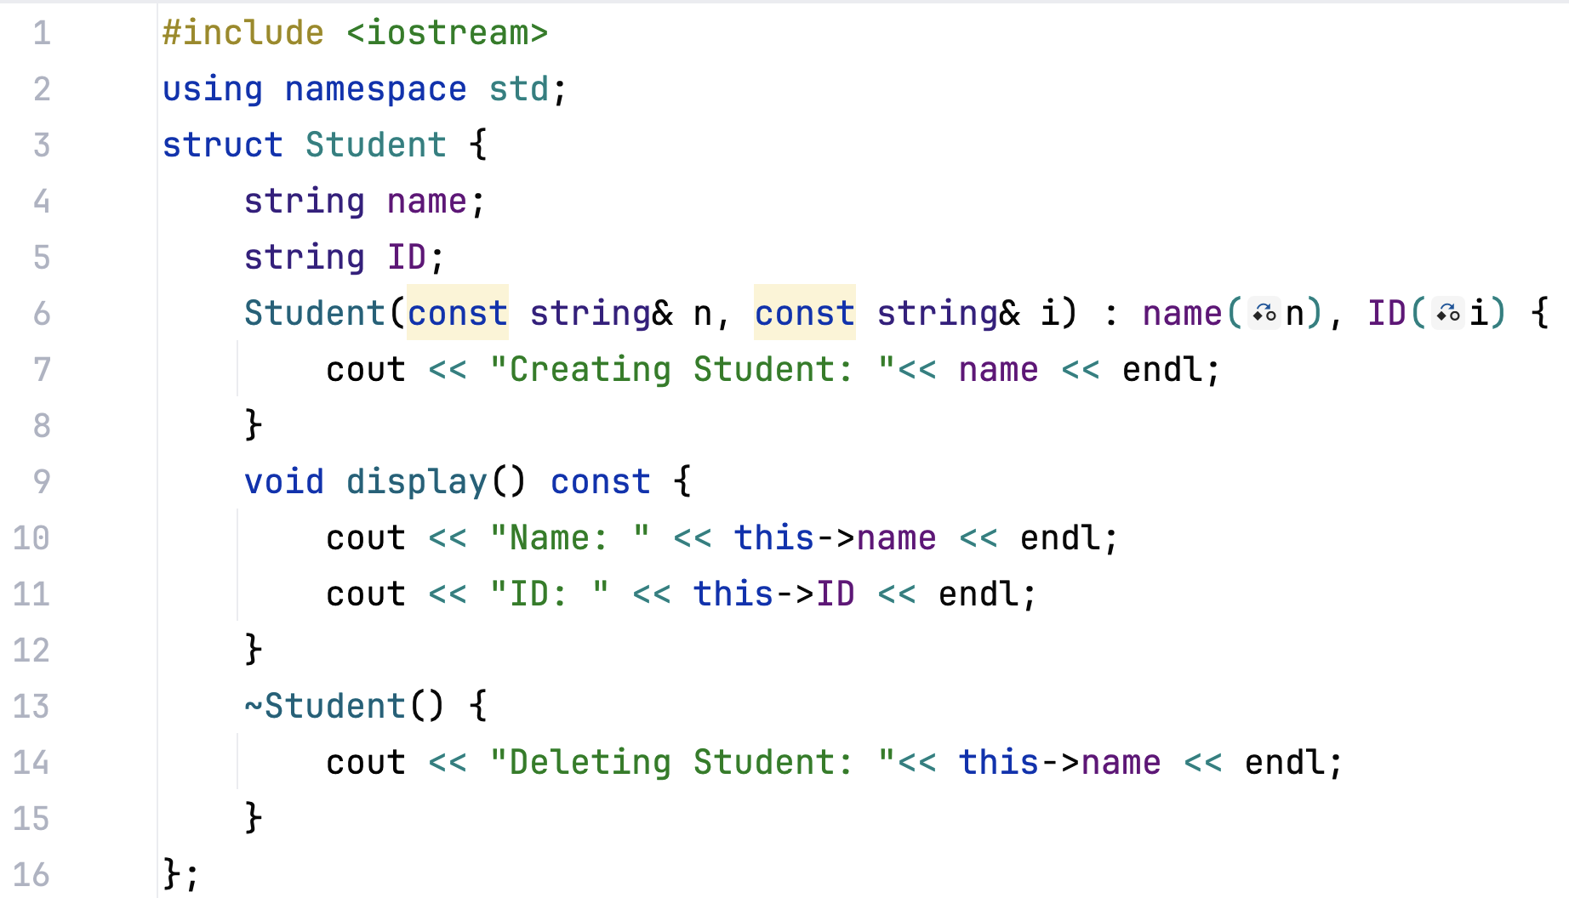
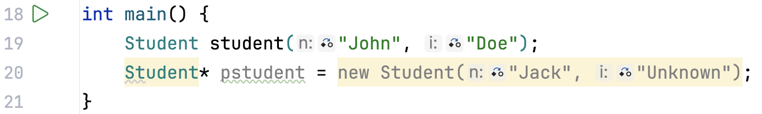
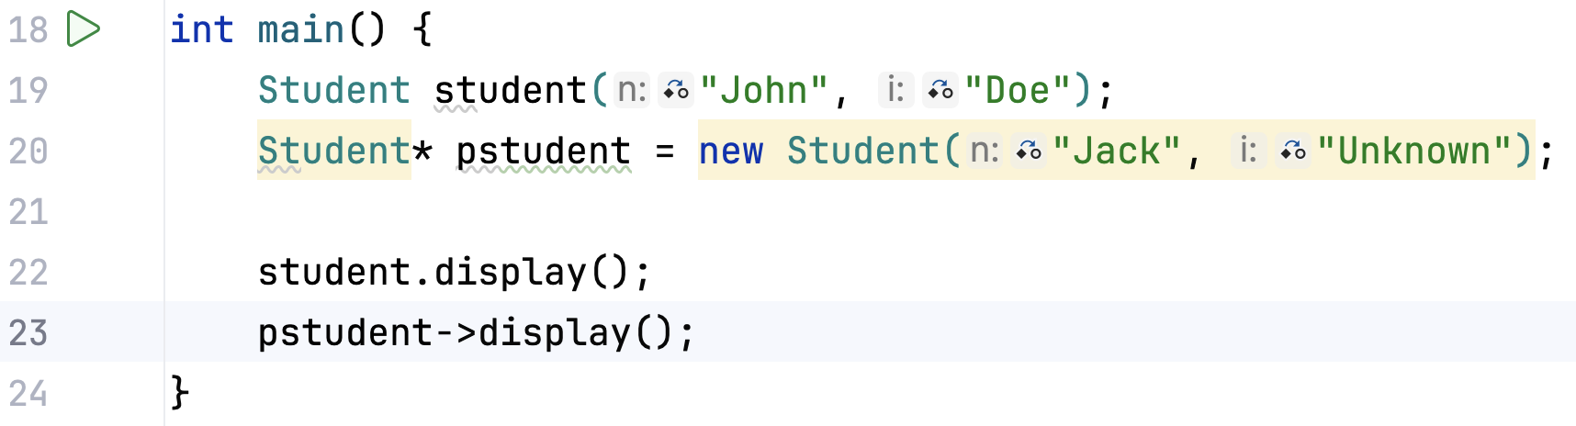
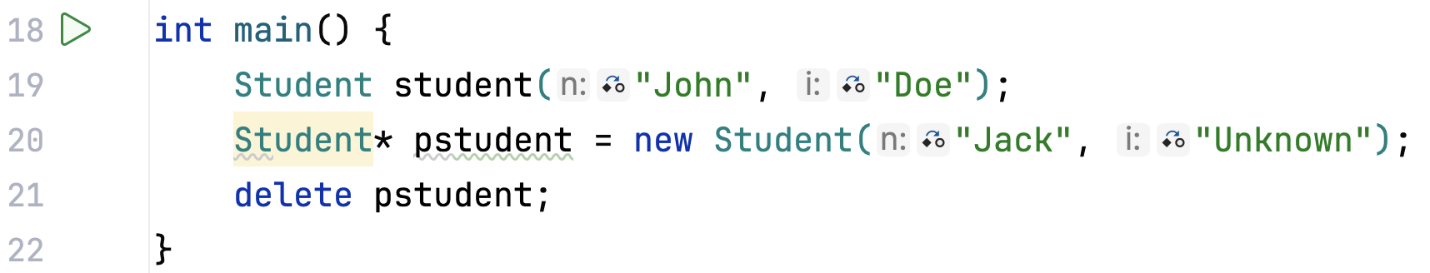
Struct […]……

Slide 36
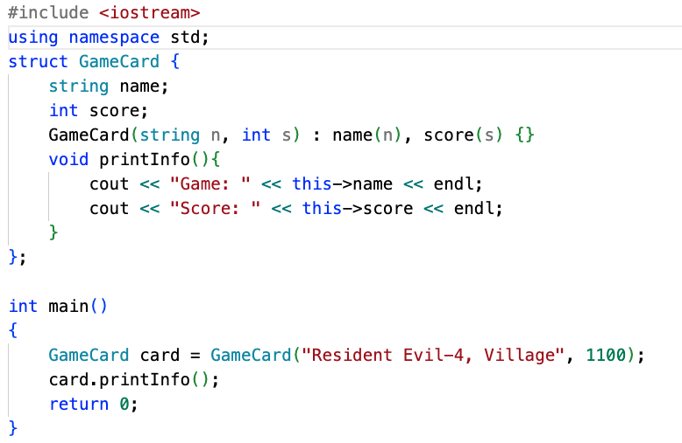

… [….]……

Slide 37
… [….]……

Slide 38
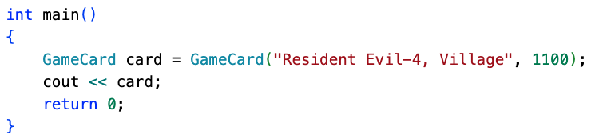
… [….]……
Can we do this?
Expectation !!

Slide 39
OP.OVERLOADING [….]……
YES.. Operator OVerloading..

Slide 40
… [….]……
YES

Slide 41
OPERATOR OVERLOADING
Unit-04.01

Slide 42
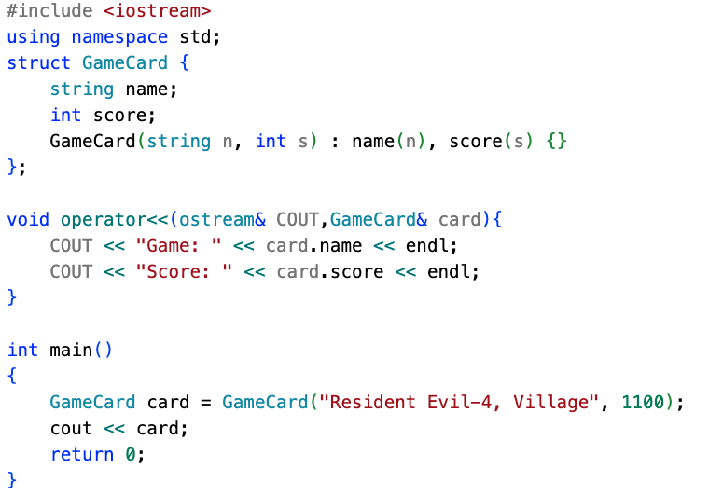
OP.OVER-LOADING [….]……

Slide 43
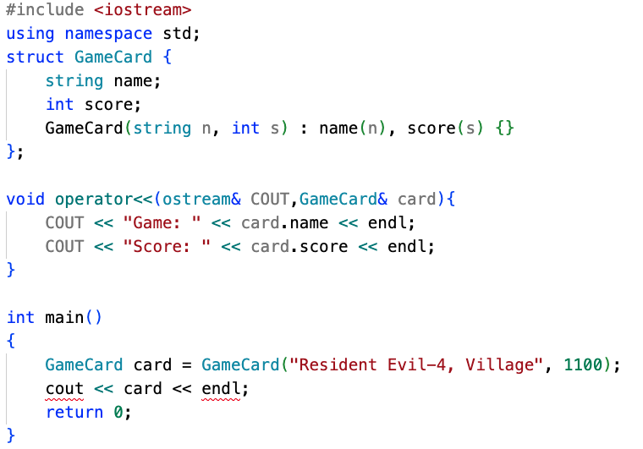
OP.OVER-LOADING [….]……
This will fail.. But why?

Slide 44
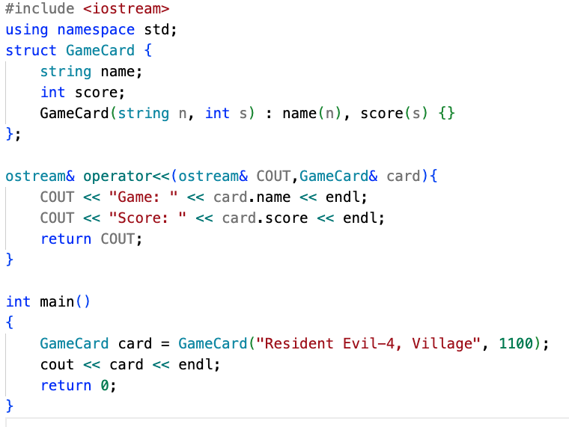

OP.OVER-LOADING [….]……
Previously…

Slide 45
OP.OVER-LOADING [….]……
We can do interesting things like..

Slide 46
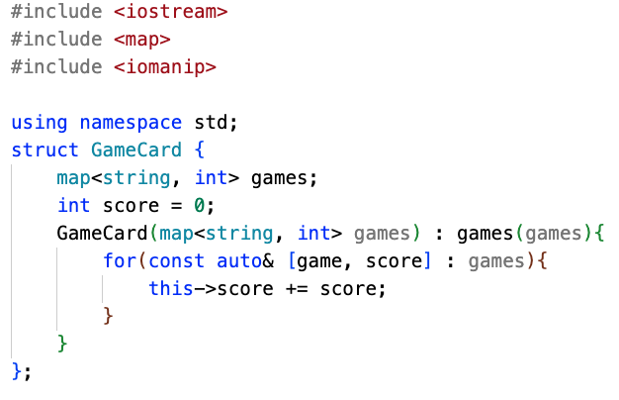
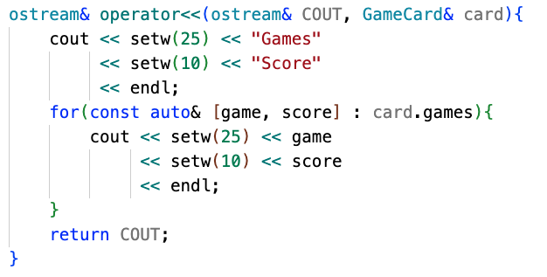
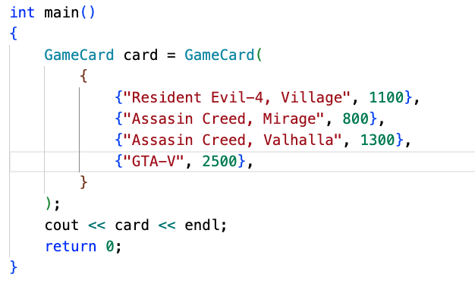
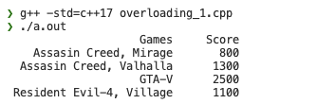
OP.OVER-LOADING [….]……

Slide 47
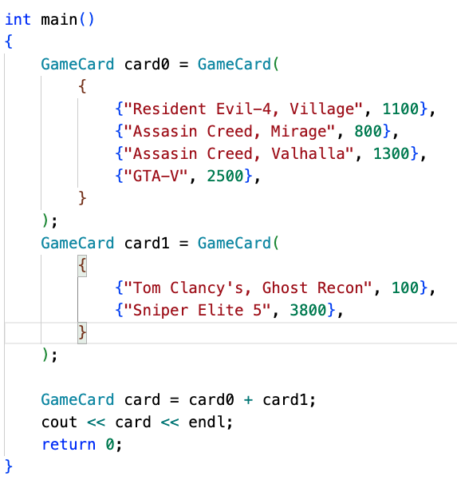
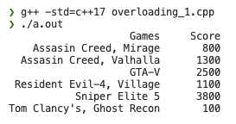
OP.OVER-LOADING [….]……
Can you modify
previous program to achieve this?

Slide 48
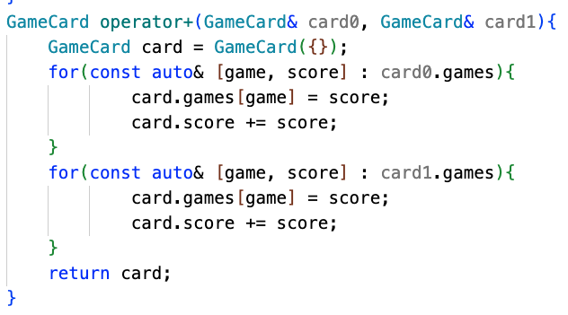
OP.OVER-LOADING [….]……
?
?
?
?
?
?
?
?
?
?
?
?
?
?
?
?
?
?

Slide 49
OP.OVER-LOADING [….]……

Slide 50
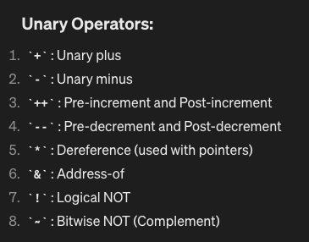
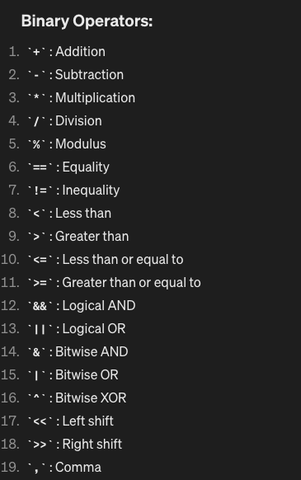
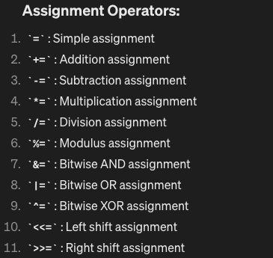
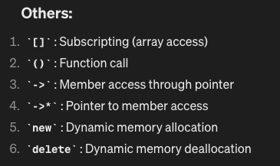
OP.OVER-LOADING [TRY THESE ??]……
I GAVE YOU THE RECIEPE
NOW BE THE CHEF…
…check if all of these are valid?
FIGURE OUT WHAT IS NOT POSSIBLE

Slide 51
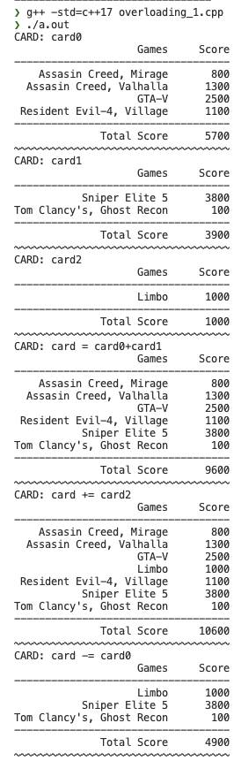
OP.OVER-LOADING [TRY THESE ??]……
+
-=
+=
Can you extend our program?

